Slide 1
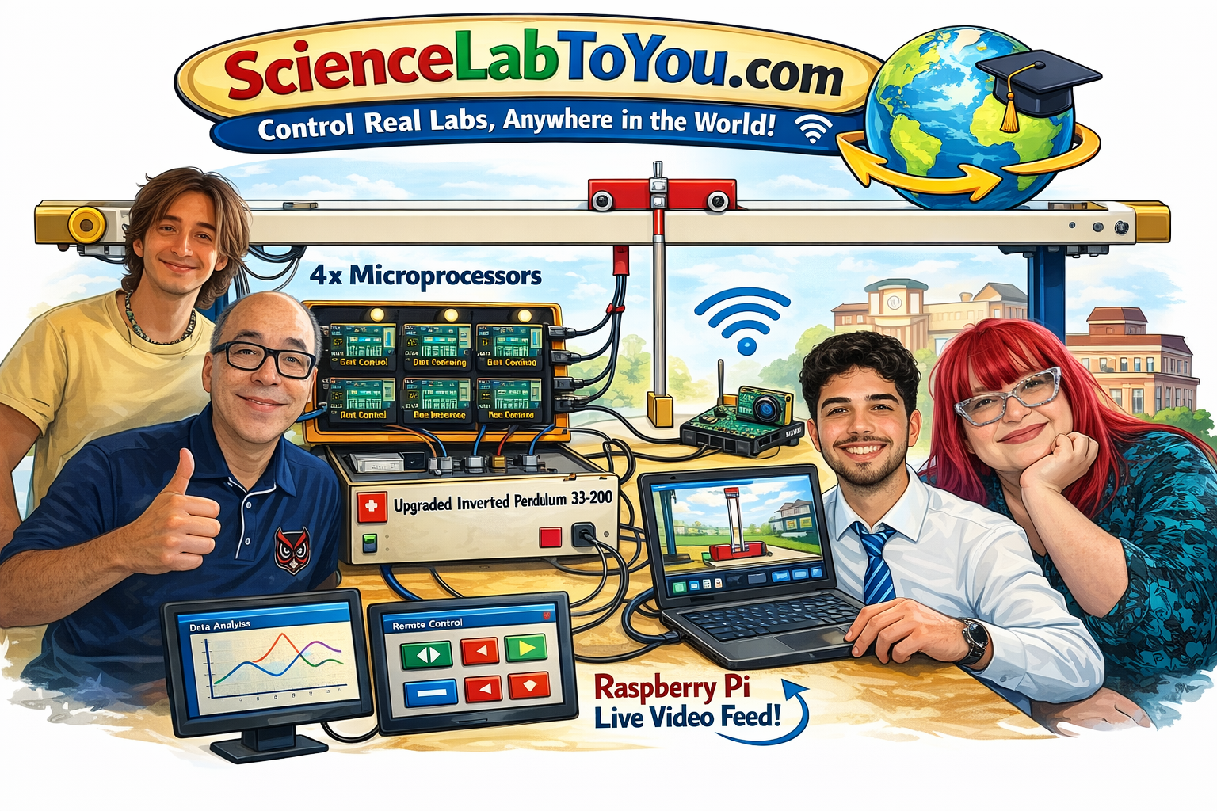
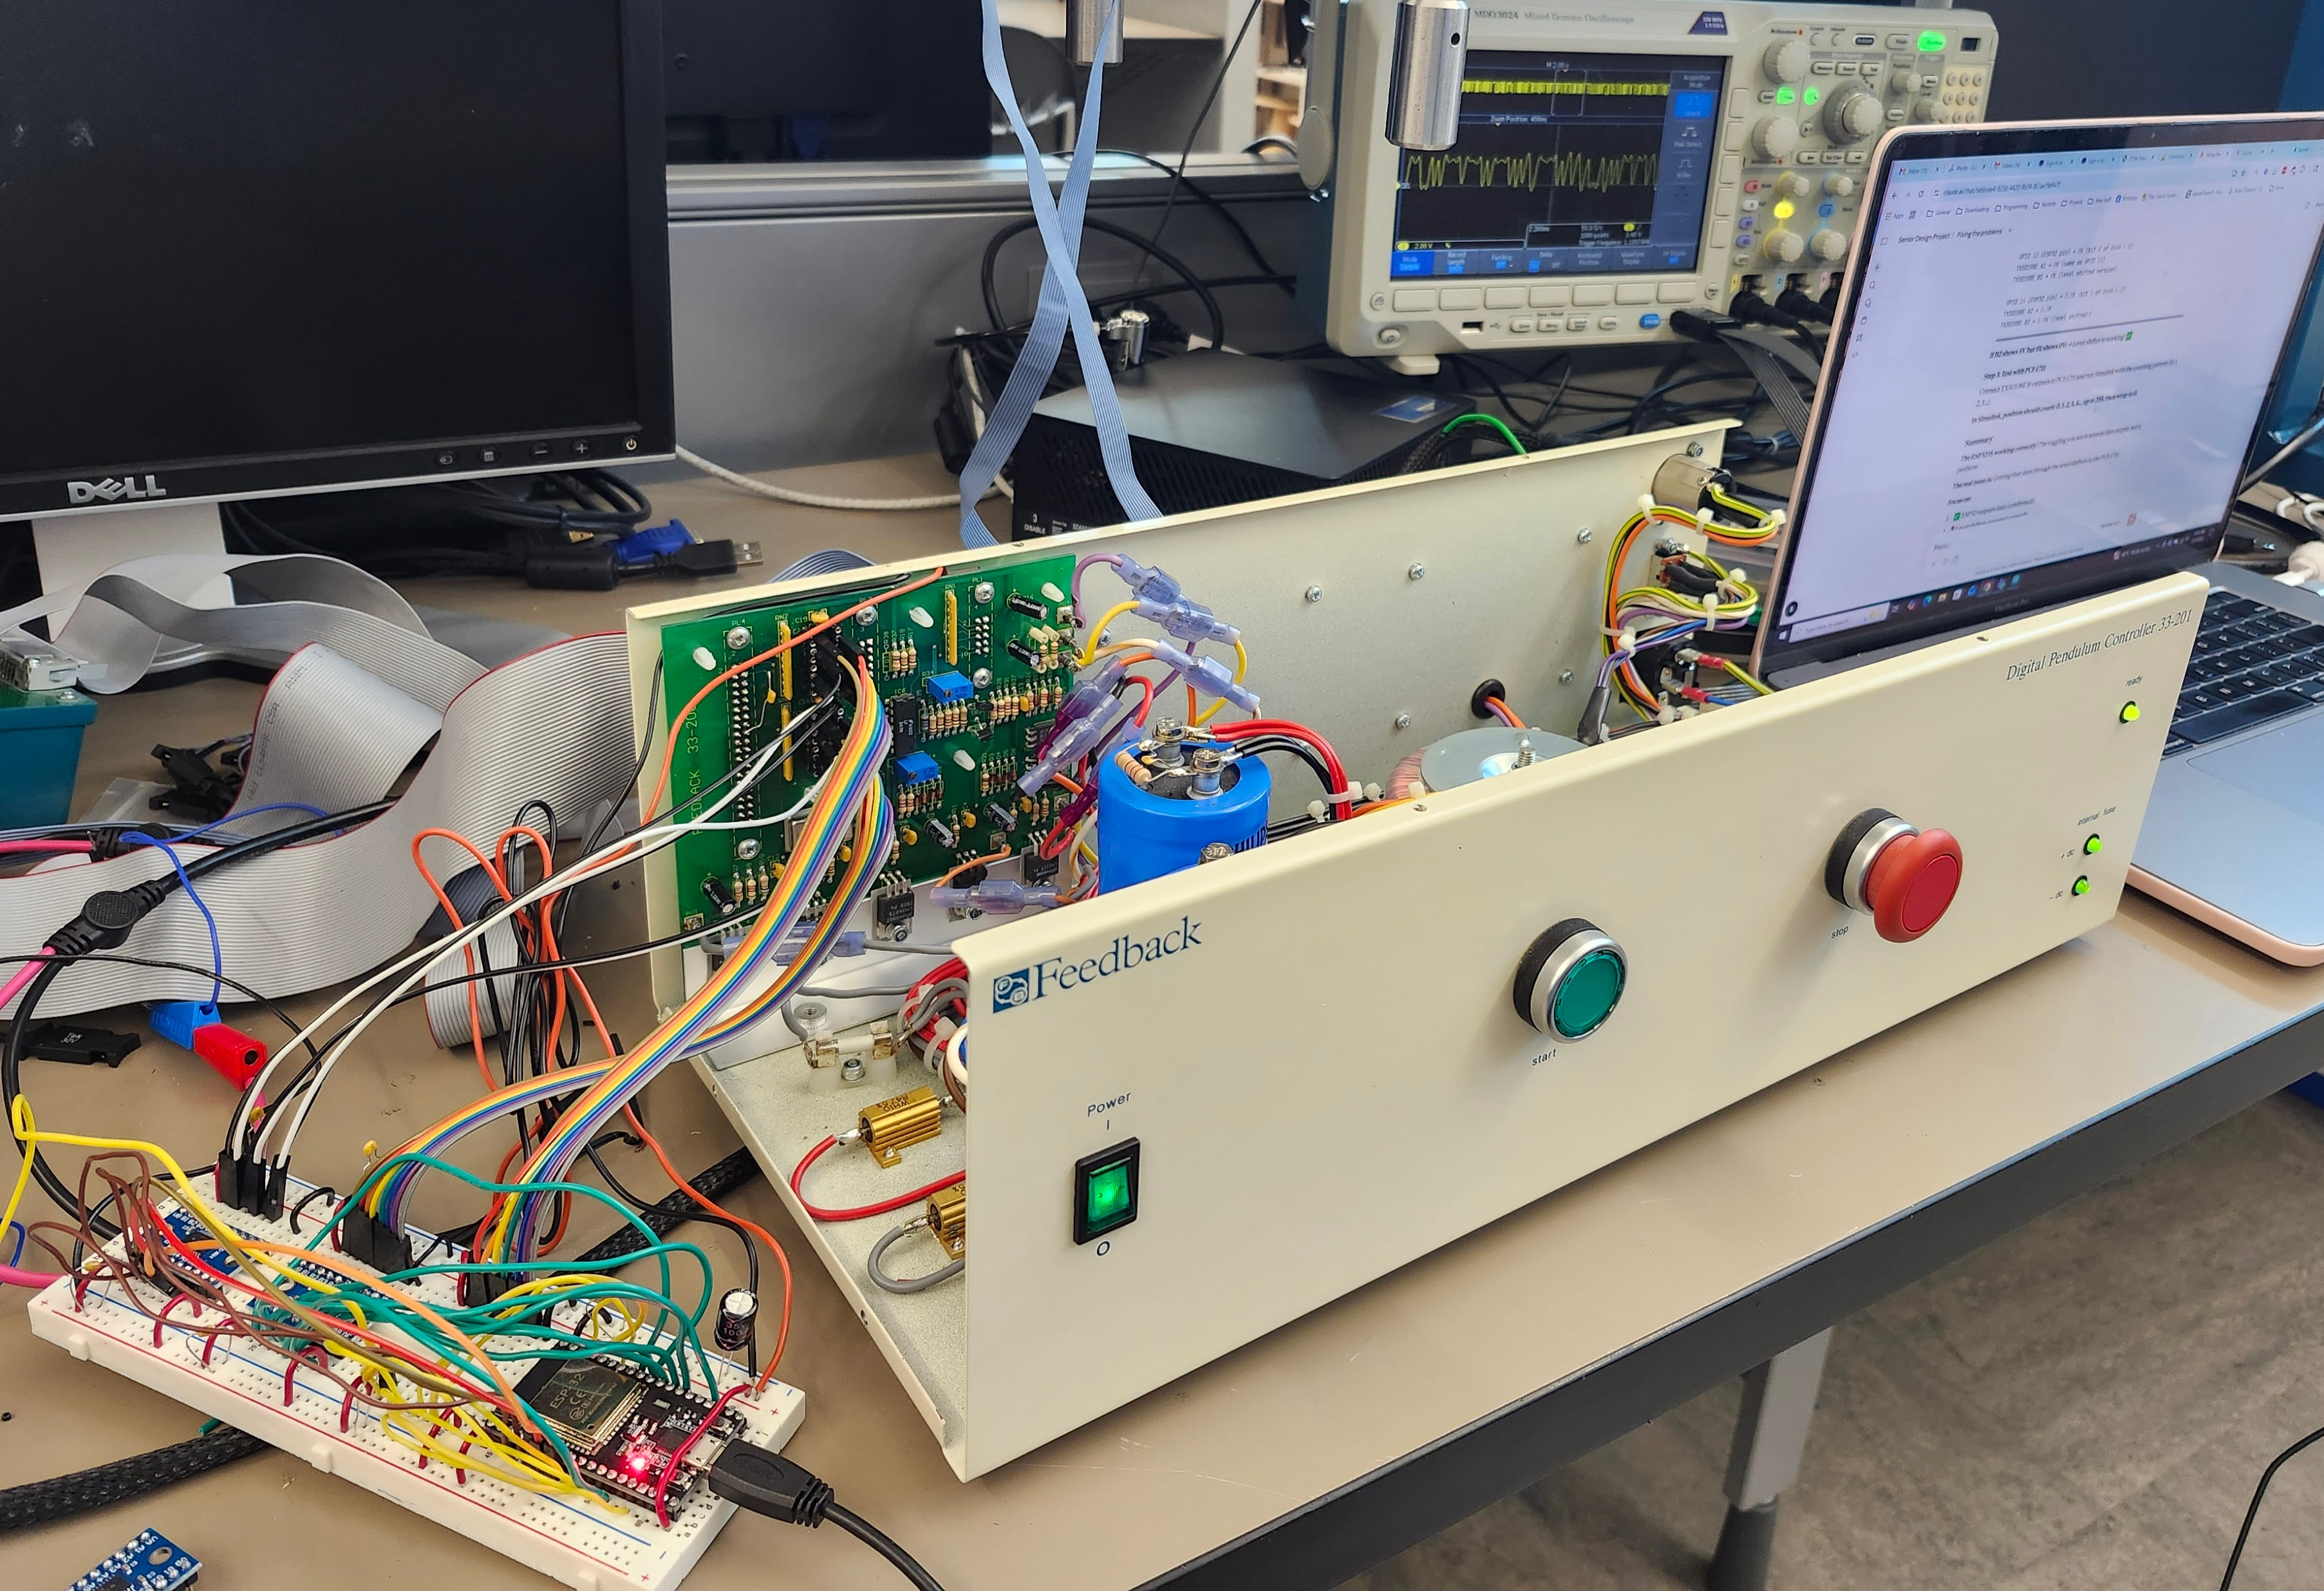
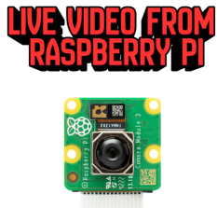
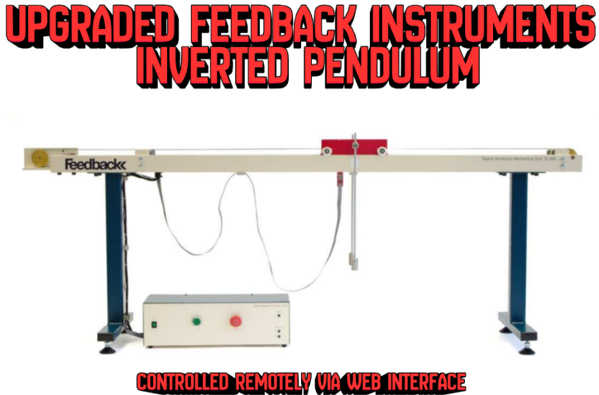
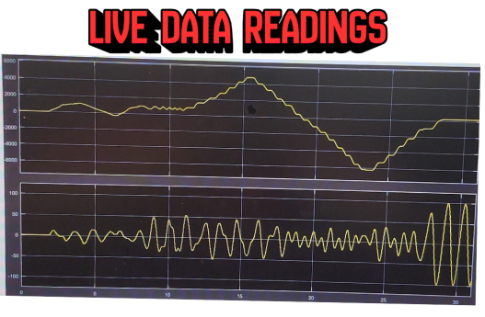

Parametric Retrofit of Lab Experiment for Remote Control
Team Members
Faculty Course Facilitator
Skylar Gutman Bruce Fong Evan King Angel Diaz Ramirez
Dr. Waseem Asghar
EGN 4952C
Electrical Engineering & Computer Science
Project Advisor
#6
Sponsored by: Dr. Perry Weinthal
Dr. Perry Weinthal
Problem Statement
The COVID-19 pandemic suddenly moved classes online. Lectures were easy to adapt… but hands-on lab work wasn’t.
The Big Challenge in STEM: You can’t build real scientific intuition by watching a screen. True lab experience — touching equipment, running experiments, and learning from mistakes — was missing.
Our Question: How can students get a genuine, hands-on lab experience… from anywhere in the world?
Results
What We Built: We took an old, broken inverted pendulum and completely upgraded it with modern hardware.
Remote Control from Anywhere: You can now control the real lab equipment using any web browser — no special software needed.
How It Works:
Change settings and send commands instantly
Watch the actual physical pendulum move in real time through a live video feed
See performance data (like speed and stability) updated live next to the video
The Best Part: It’s not a simulation. The equipment is real, the lab is real, and every interaction happens live.
Conclusions & Impact
Remote Labs Are the Real Deal Remote lab access isn’t just a temporary fix anymore — it’s a legitimate way to learn engineering.
What This Project Shows A student anywhere in the country (or even across the world) can now control real lab equipment just as effectively as someone standing right next to it.
Why This Matters
Opens doors for students who don’t have access to fancy labs
Removes scheduling conflicts and location problems
Keeps real hands-on learning alive even when you can’t be on campus
The Bigger Picture What began as a solution for the pandemic is becoming a new standard for accessible and flexible STEM education.

